Slide 1
26G Mentor-Mentee TRAINING
final presentation
nov 2017 – nov 2019
Mentor: Vinh luong (055)
Mentee: hieu tran (2040)
Team: tool development
Group: Broad base tools 3
Renesas design vietnam co., ltd.
Renesas Electronics Corporation

Slide 2
Agenda
Training target & Result Page 03
Activities & Achievements Page 06
Difficulty & Solution Page 12
Plan Page 13

Slide 3
Training target & Result
Training target & Result (1/3)​
Activities & Achievements
Difficulty & Solutions
Plan
Achieve “Software Design Engineer” with role Level 2 by November, 2019
=> Do IDE Design Task without support, if it is within certain degree of difficult.
Role | Skill | Description | Target Level | Current level
Engineer for software design | Software Functional Design | Decide the structure of software according to given software requirement definitions. | 2 | 2
 | Software Detailed Design | Conduct a detailed software design according to given software structure definitions. | 2 | 2
Coding engineer | Software Coding | Have sufficient knowledge of programming language and create a program based on the detail design document Conduct a code review of created code. | 2 | 2
 | Readability | Have knowledge of techniques for improving the source code readability and perform coding accordingly. | 2 | 2

Slide 4
Training target & Result
Training target & Result (2/3)​
Activities & Achievements
Difficulty & Solutions
Plan
Achieve “Software Design Engineer” with role Level 2 by November, 2019
=> Do IDE Design Task without support, if it is within certain degree of difficult.
Role | Skill | Description | Target Level | Current level
Engineer for testing | Test environment setup | Have knowledge to set up test environment (set up environment, configure boards/devices, …). | 2 | 2
 | Testing | Conduct tests according to the test specifications | 2 | 2
 | Failure analysis | Locate the cause of any trouble and make analysis to find and fix similar bug | 2 | 2

Slide 5
Training target & Result
Training target & Result (3/3)​
Activities & Achievements
Difficulty & Solutions
Plan
Achieve “Software Design Engineer” with role Level 2 by November, 2019
=> Do IDE Design Task without support, if it is within certain degree of difficult.
Skill | Description | Current level
Development Process | Know/Understand and can follow Development process Can evaluate the results to find and improve weak phase of the process. | Achieved
Communication skill | Can express idea to others. Can report status/issues/solutions to teammates. | Achieved
Management Ability | Can schedule works and follow the schedule Can manage common risk for assigned tasks: private issues (health,…), technical issues (lack of experience in assigned fields),… | Achieved

Slide 6

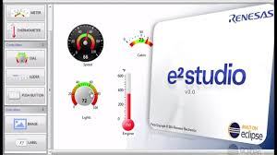

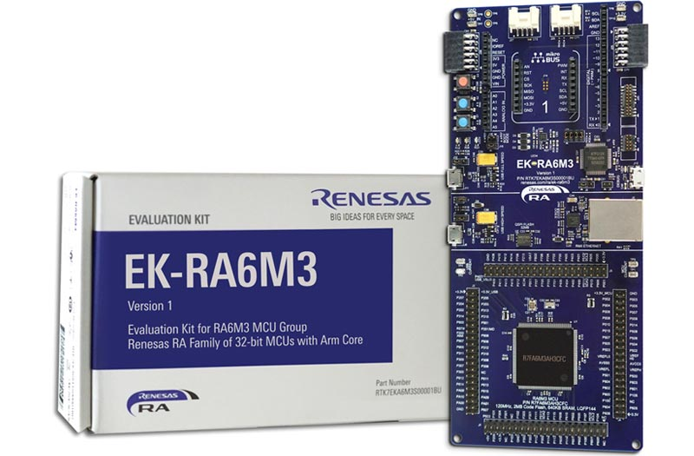


Activities & Achievements
Training target & Result
Activities & Achievements (1/6)
Difficulty & Solutions
Plan
Development environment
Activities
Read and follow guideline documents
Confirm and get support from experience engineers
Achievements
Can setup development environment (target platform, baseline, Git…).
Can use and configures most boards/devices/emulator in development.
Can use system tools to support tasks smoothly (JIRA, Confluence, Gerrit, Jenkins, …)
Can support new member to setup environment.

Slide 7
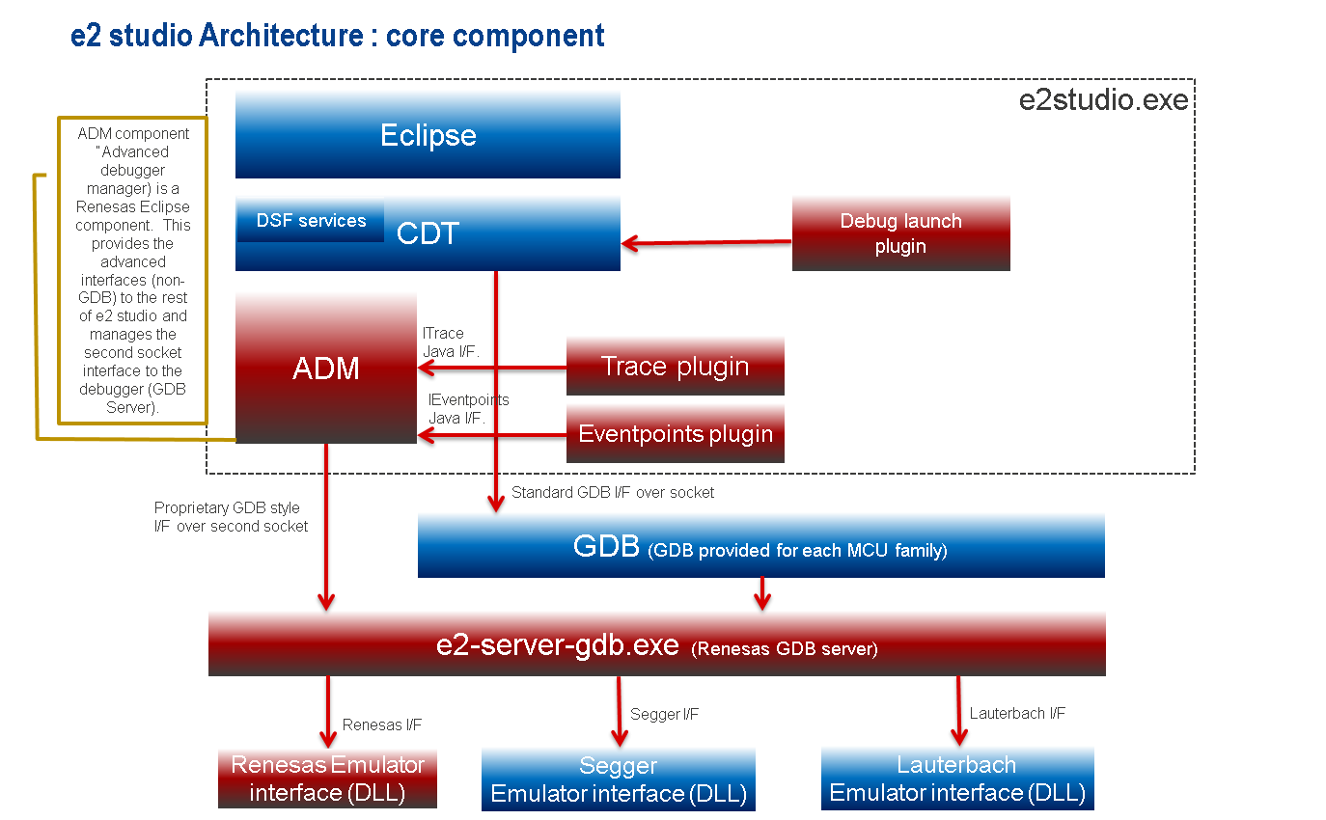
Activities & Achievements
Training target & Result
Activities & Achievements (2/6)
Difficulty & Solutions
Plan
E2studio debugger
Activities
Train through daily tasks in team (from GUI tasks to GDB server tasks and combination tasks).
Achievements
Know basic layers and flow of e2studio
Understand flow and how to communicate between layers
Can debug flow from GUI to GDB Server through ADM
Can in charge tasks in GUI, ADM also basic tasks in GDB Server.

Slide 8
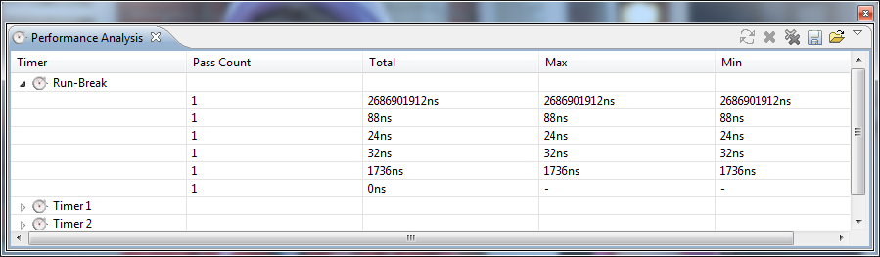
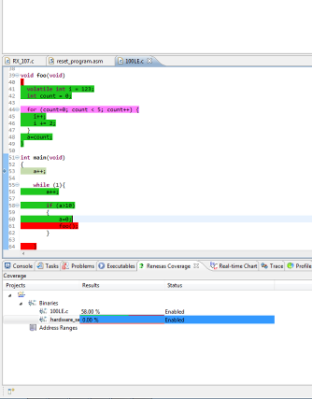
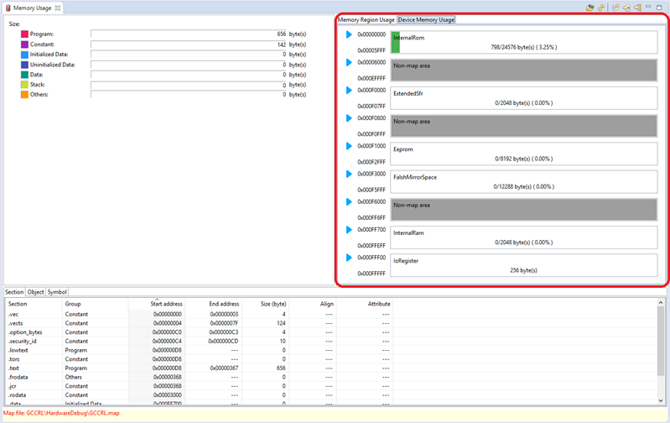
Activities & Achievements
Training target & Result
Activities & Achievements (3/6)
Difficulty & Solutions
Plan
Functional Design & Detailed Design
Activities
Train through daily tasks in team with feature tasks
Investigate requirement, existing design, propose idea(s), create F.S to confirm via review
Join tasks for improvement, feature (restructure Coverage plugin, new feature for Memory Usage)
Propose structure and internal processing flow
Create D.S and confirm via review.
Achievements
Can create F.S, D.S, implementation note without support
Can support to review basic F.S, D,S, implementation note
Understand deeply structure and processing flow of plugins

Slide 9
Activities & Achievements
Training target & Result
Activities & Achievements (4/6)
Difficulty & Solutions
Plan
Coding & Development knowledge
Activities
Train through daily tasks in team with feature tasks
Challenge to tasks using new technology
Achievements
Have knowledge about GUI library (SWT, JavaFx)
Have knowledge about thread, job
Have knowledge about Collection (List, Set, Map, …)
Can create plugin/RCP application.
Know how to use debugging from Eclipse (Java side) to Visual studio (GDB Server side).
Have basic knowledge about DSF service.
Can support to review source code.

Slide 10
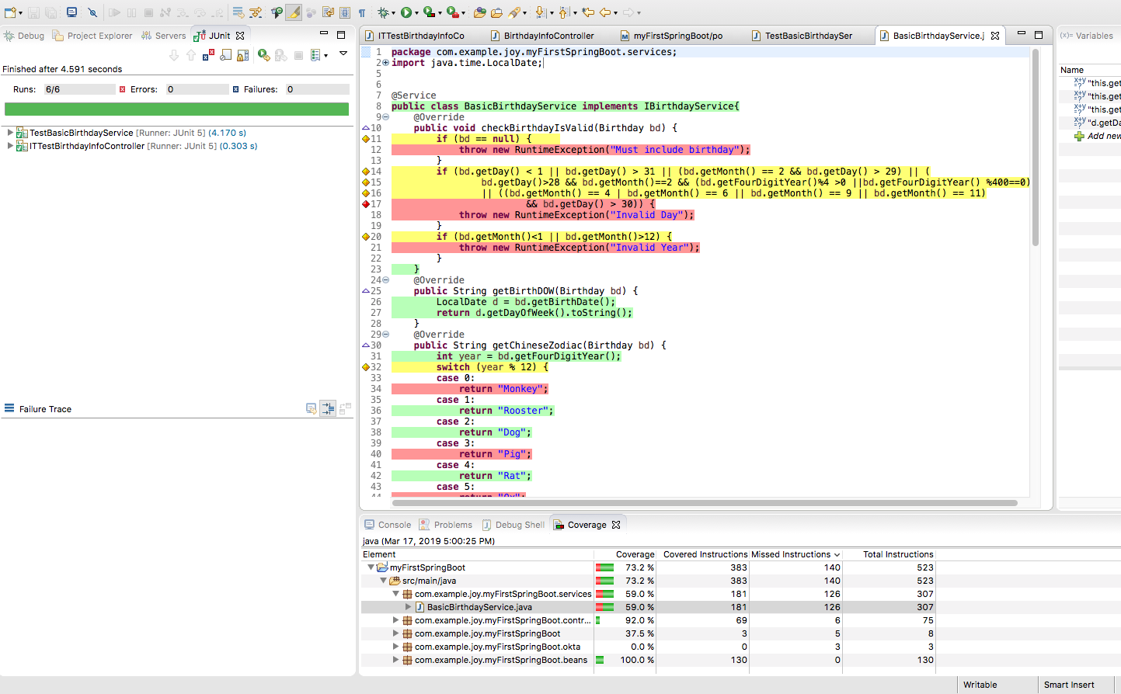


Activities & Achievements
Training target & Result
Activities & Achievements (5/6)
Difficulty & Solutions
Plan
Testing
Activities
Create test cases (UT, IT) for daily tasks.
Create automation test (Junit, RCPTT)
Achievements
Can create test cases to cover source code, also use case
Can create and review test scripts from existing test cases
Can analyze fail cases to determine root cause.
Can review test cases, also test scripts

Slide 11
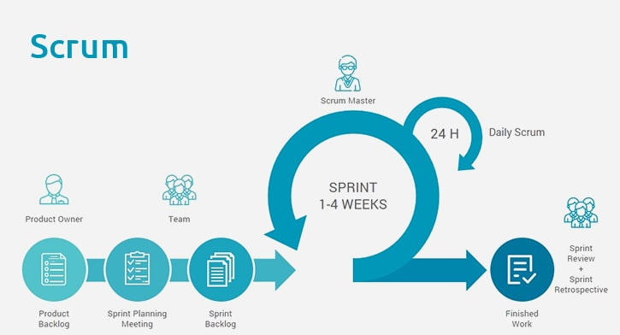

Activities & Achievements
Training target & Result
Activities & Achievements (6/6)
Difficulty & Solutions
Plan
Development process
Activities
Read and following project plan to apply daily tasks.
Achievements
Understand and apply Agile to daily tasks.
Communication skill
Activities
Think in reader’s view point.
Share knowledge and training new members
Achievements
Can discuss and confirm with customer/other members about requirement/tasks.
Can support to train new members

Slide 12
Difficulty & solutions
Training target & Result
Activities & Achievements
Difficulty & Solutions (1/1)
Plan
Difficulty | Solutions
Lack of user view point | Create documents to confirm to other members/ customers before implementation
Lack of general view point to make design for plugin. This makes restructure plugin tasks conflict together. | Confirm to experience engineer to get idea(s), solutions Refer other design and investigate to understand processing flow/spec deeply

Slide 13
Plan
Training target & Result
Activities & Achievements
Difficulty & Solutions
Plan (1/1)
Study about ARM architecture for future tasks
Improve development skills, also design skills
Improve management skills

Slide 14
Thank you for listening

